Slide 1
CCLE Integrative Project
7/9/20

Slide 2
Data Summary
34 breast cancer cell lines
Positive or negative for ER-alpha/ESR1
Originally 47 cell lines, but after PCA to look at batch effect, some were filtered to make downstream analysis easier
RNA-seq
Normalization: TPM
RPPA
Normalization: log2 median-centered
Notes:
ER-alpha based on RPPA data

Slide 3
Steps
Get common genes between RNA-seq and RPPA datasets
Calculate FC for these common genes for RNA and RPPA (total protein values) datasets
Log2(FC) = log2(positive / negative)
Linear regression transformation
RNA = m*RPPA + b
All RPPA values (total and phosphorylated) were transformed into RNA space
Calculate new FC for RPPA combining total and phosphorylated values
FC = phosphorylated / total
Pathway Analysis
DAVID, GSEA, MetaCore

Slide 4
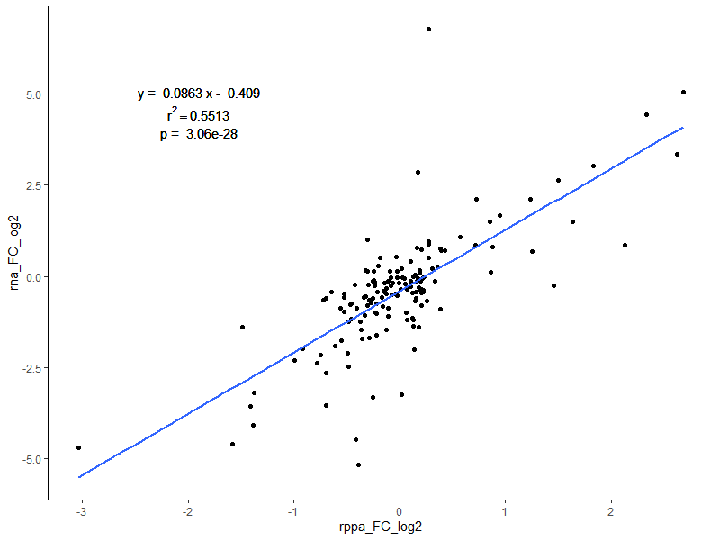
Linear Regression Transformation

Slide 5
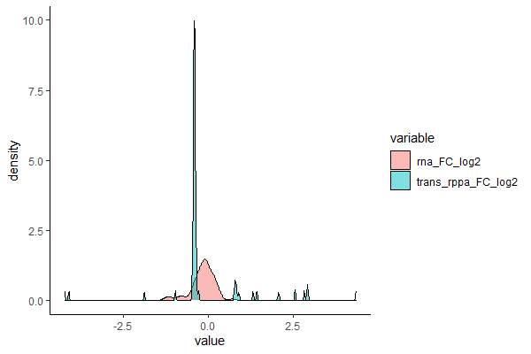
Transformation Stats:
RNA
Transformed RPPA
Max FC
RNA | RPPA | Total
34415 | 96 | 34511
Notes:
Stats of transformed data
There is a shift in the mean between RNA and RPPA values
Some max FC values are transformed RPPA values

Slide 6
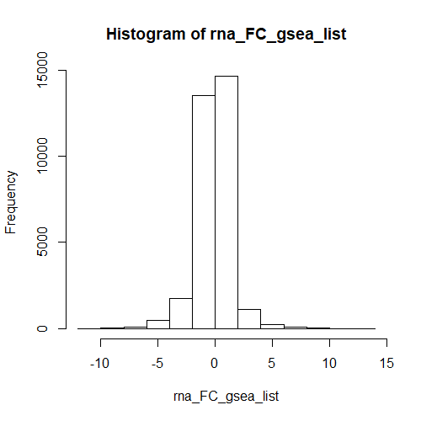
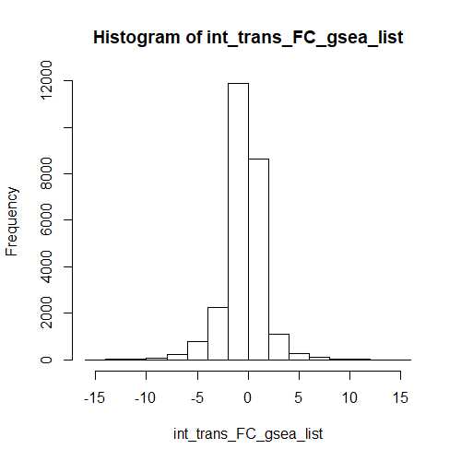
Transformation Stats
RNA-only FC (DESeq2)
Integrative FC
Notes:
Used two gene lists:
Genes and FCs from RNA-only dataset (DESeq2)
Genes and FCs from integrative dataset
Seems to be a slight shift to the left when comparing RNA-only to Integrative dataset
Integrative gene list has less genes than RNA-only because of more Inf

Slide 7
Pathway Analysis: Transformed

Slide 8
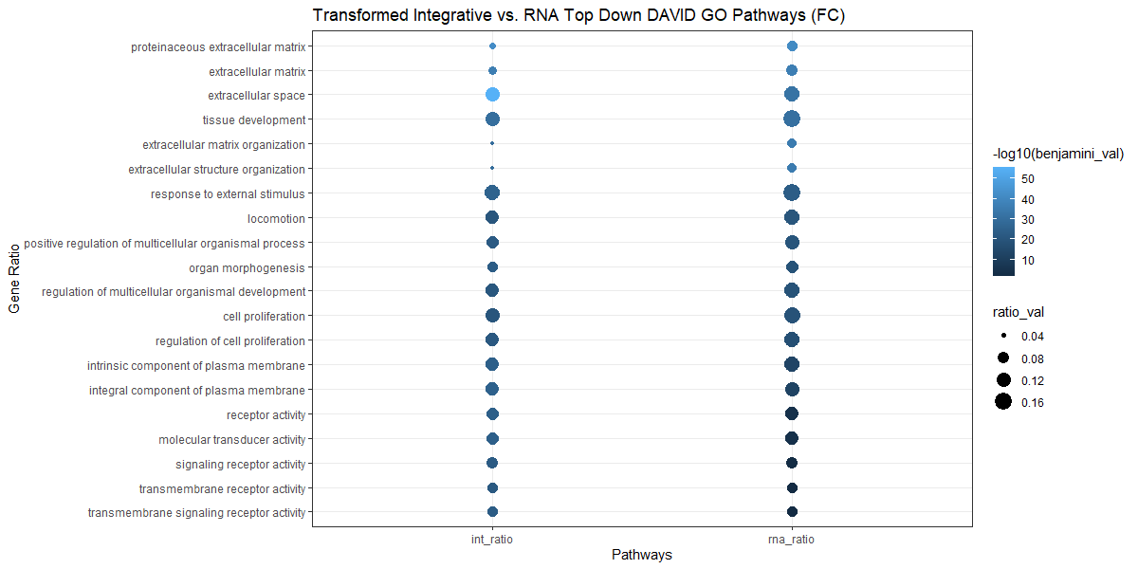
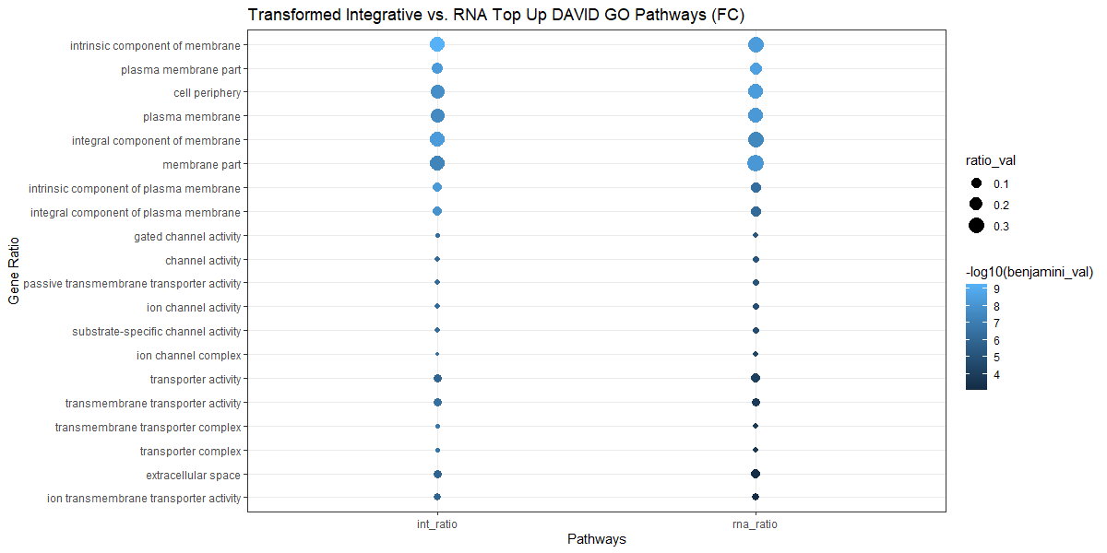
DAVID: Integrative vs. RNA Common Paths (GO)
Notes:
Larger –log10(benjamini_val) = more significant
Larger ratio_val = more genes in pathway gene set

Slide 9
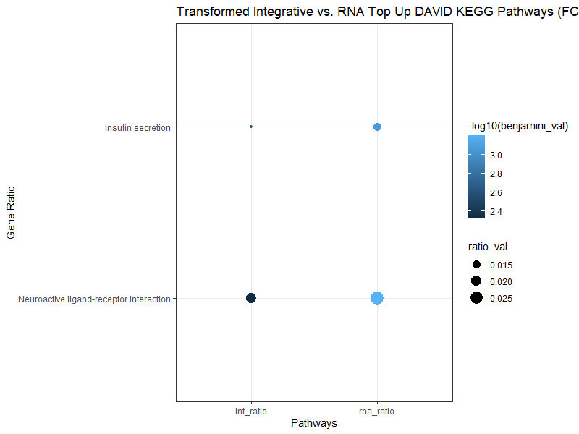
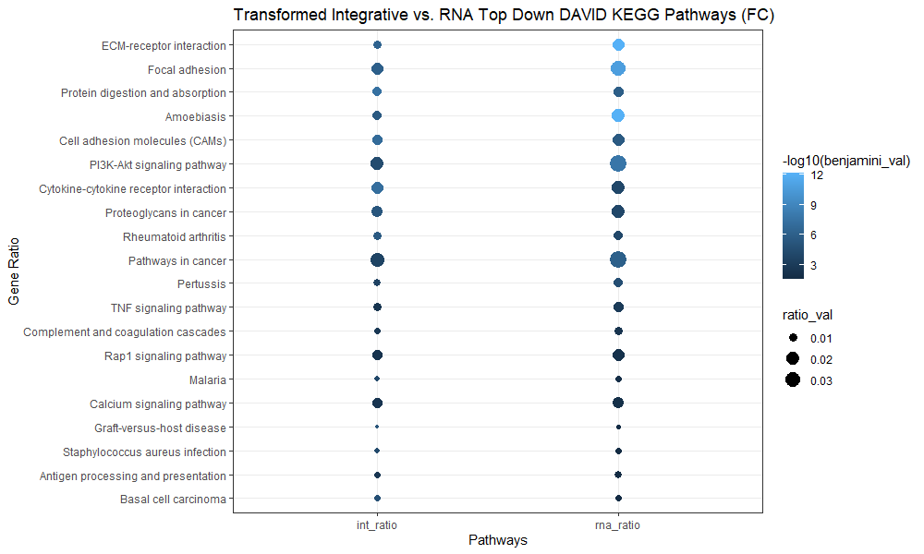
DAVID: Integrative vs. RNA Common Paths (KEGG)

Slide 10
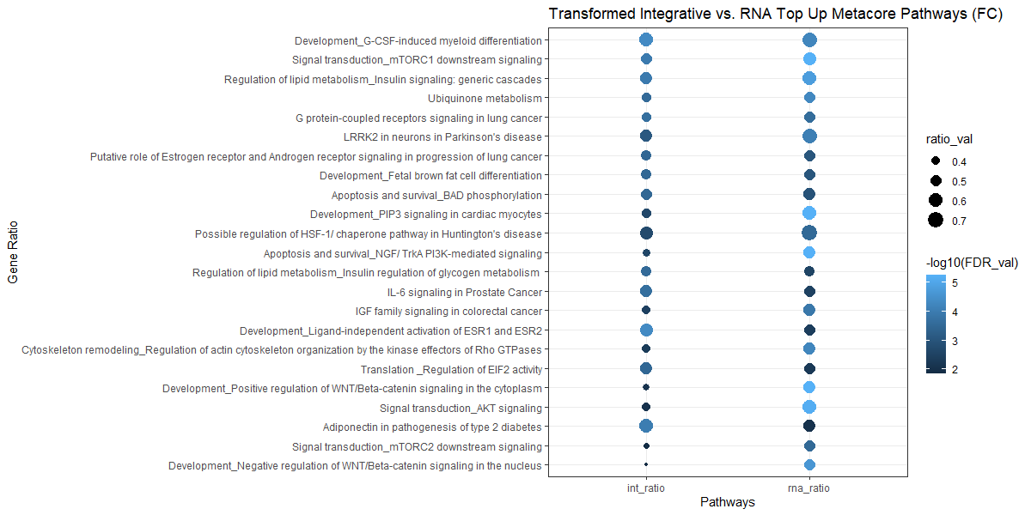
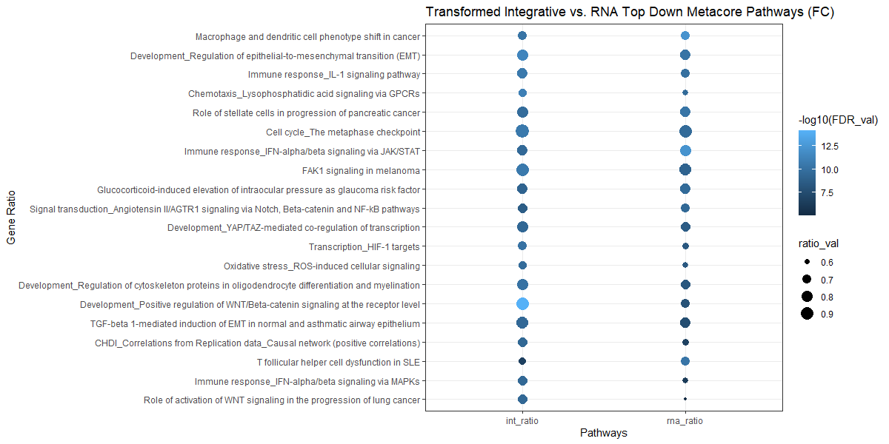
MetaCore: Integrative vs. RNA Common Paths
Notes:
Finding that MetaCore mostly does over-representation analysis

Slide 11
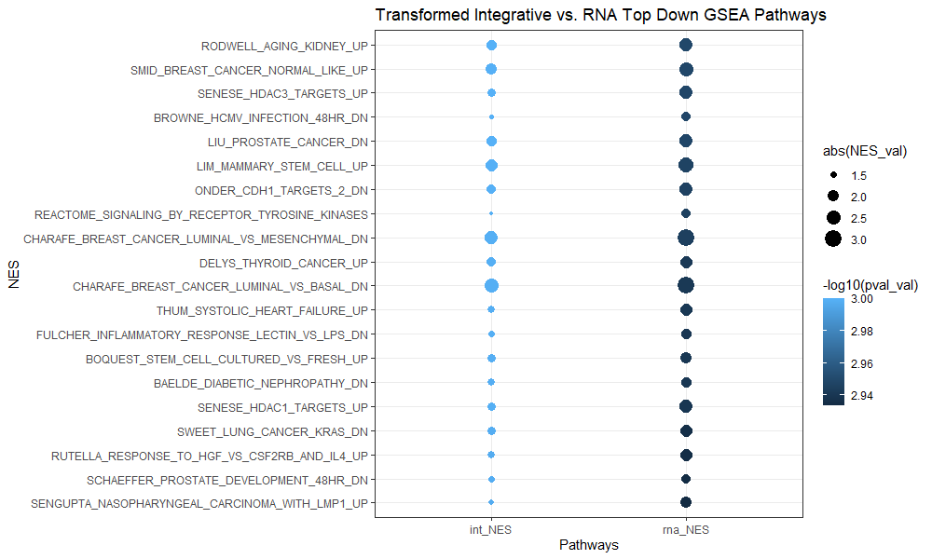
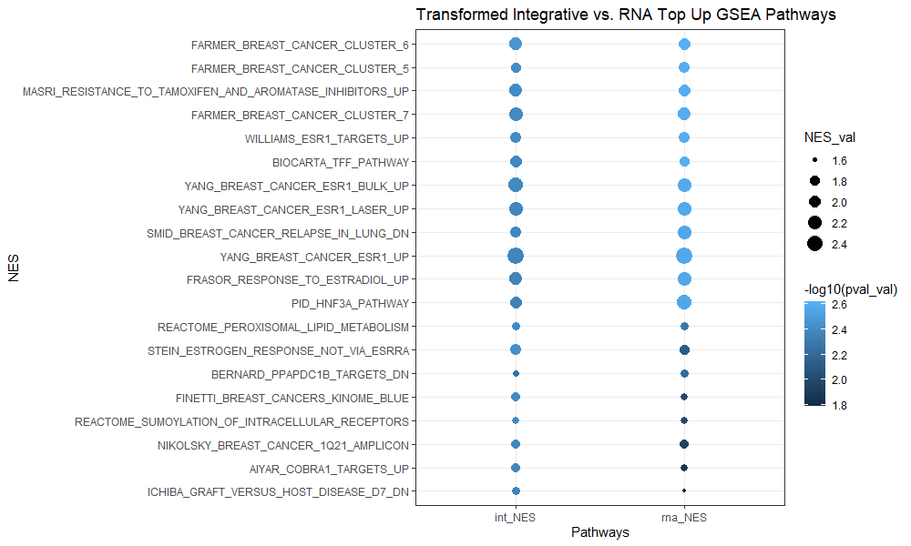
GSEA: Integrative vs. RNA Common Paths
Notes:
Upregulated pathways:
Larger NES_val = larger enrichment
Larger –log10(pval_val) = more significant
Downregulated pathways:
Larger abs(NES_val) = larger enrichment
Larger –log10(pval_val) = more significant
Seem to be bringing up pathways more related to breast cancer than before (which brought up eye pathways

Slide 12
GSEA: NES and q-value comparisons
Same NES direction; both q < .05 | Same NES direction; int q < .05 | Same NES direction; rna q < .05 | Different NES direction; both q < .05 | Different NES direction; int q < .05 | Different NES direction; rna q < .05 | Both q > .05
624 | 25 | 848 | 0 | 0 | 3 | 3172
Notes:
Have quite a lot of pathways that match in direction and are significant
Have quite a lot of pathways that match in direction but only RNA NES are significant
Have some pathways that match in direction but only int NES are significant

Slide 13
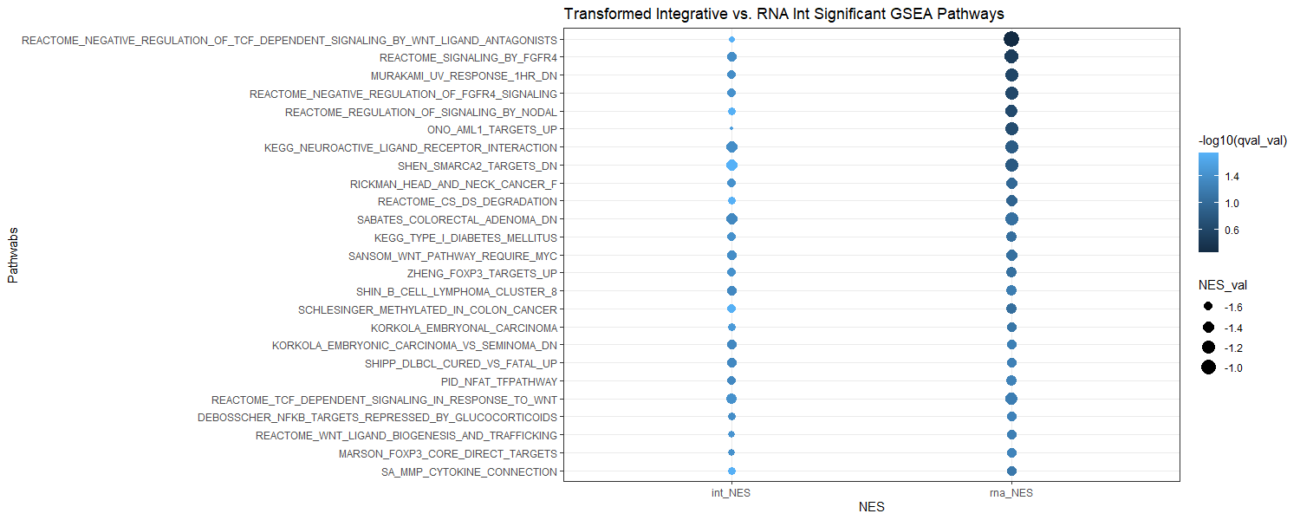
GSEA: Same NES Direction; Integrative Significant
Notes:
Smaller NES_val = larger enrichment
Larger –log10(qval_val) = more significant
New pathways added with integrative dataset
Made more significant
Mostly downregulated pathways
Would these be relevant to breast cancer?

Slide 14
Conclusions:
Transforming FCs instead of means works better.
Slight shift of transformed values to the left (more negative FCs)
More pathways that agree in directions and are significant
Lots of pathways that are significant for RNA-pathways
Pathway tools:
MetaCore is good for over-enrichment analysis
GSEA seems to work well with MSIGDB database
Was unable to test IPA, but assuming that it is good if considers FCs
Limitations:
Shift in values?
Less genes in integrative vs. RNA-only dataset

